Slide 1
Architecture Design for Handling Business Traffic Peak

Slide 2
Objectives
After completing this course, you will be able to:
Understand the principles of building an architecture for handling peak traffic in Tencent Cloud;
Understand how to design a user and application access layer architecture for handling peak traffic in Tencent Cloud;
Understand how to design a web and service layer architecture for handling peak traffic in Tencent Cloud;
Understand how to design a data cache layer architecture for handling peak traffic in Tencent Cloud;
Understand how to design an async message queue layer architecture for handling peak traffic in Tencent Cloud;
Understand how to design a data layer architecture for handling peak traffic in Tencent Cloud;
Understand how to handle exceptional peak traffic based on Anti-DDoS.
Notes:
Understand problems of peak traffics, and how do we handle them in general. And we will deep-dive into designing System Architecture that withstand the high-volume traffic.

Slide 3
Section 1. Overview of Peak Business Traffic Handling
Section 2. Handling Traffic Peak at User and Application Access Layer
Section 3. Handling Traffic Peak at Web and Service Layer
CONTENTS
Section 4. Data Cache Architecture Design
Section 5. Async Message Queue Architecture Design
Section 6. Handling Traffic Peak at Data Layer
Section 7. Exceptional Peak Traffic Handling Schemes

Slide 4
Section 1. Overview of Peak Business Traffic Handling
Section 1. Evolution of Cloud Computing
1.1 Challenges of business traffic peak
CONTENTS
1.2 Planning business traffic peak handling

Slide 5
1.1 Challenges of business traffic peak
Categories of peak traffic scenarios:
Normal peak traffic
Exceptional peak traffic
Daily high concurrent traffic
Attack traffic
Traffic surges
Notes:
First of all, there are 2 types of Peak Traffic, Good and Bad

Slide 6
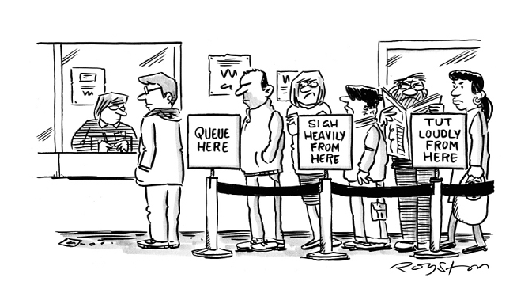
1.1 Challenges of business traffic peak (continued)
What is a peak traffic scenario?
Our service is like a cashier. The longer the queue, the busier the cashier. For a system, it means that high numbers of concurrent access requests sent to the terminal in a short period of time cause the system to be highly loaded.
Notes:
思考如何提高收银服务的处理能力？
其一是提高收银员的处理速度，他们处理的越快，单位时间内就能服务更多的顾客；
其二是增加人手，一名收银员处理不过来，我们就雇十名收银员，十名不够我们就雇佣一百名（如果不计成本）；
其三是减少访问人数，也即分流过滤，将一些人提前过滤掉，或做活动预热（比如双十一预热），在高峰之前先满足一部分人的需求。

Slide 7
1.1 Challenges of business traffic peak (continued)
Problems that may be caused by peak traffic:
Reduced service capacity, access delay, and poor user experience
Deteriorated overall system performance
Service downtime and system crash, rendering the service unavailable
Exceptional traffic attacks, posing security threats
How do we handle peak traffic scenarios?
Notes:
Problems with Peak Traffic includes: (system is busy)
1. Delay, Poor user experience
2. Slow Performance (for non-user interaction systems)
3. Too busy until crash
4. (If it is the bad Traffic) Security Threats

Slide 8
1.2 Planning business traffic peak handling
Design principles of handling Peak Traffic:
Service Grading: grade enterprise businesses and set different levels of availability and reliability for different businesses;
Business Isolation: isolate core businesses from supporting systems and isolate businesses that face peak traffic from other businesses;
Service Downgrading: make sure that core businesses are available while non-core businesses are weakly available or unavailable in emergencies;
Service Time Division: provide services during specific periods to reduce the instantaneous peak;
Capacity Planning: plan capacity based on traffic peak for businesses that face peak traffic (horizontal and vertical capacity);
Architecture Layering: use access layer - application layer - middleware layer - data layer;
Async Processing: implement async processing through message queue to shift the peak and reduce the instantaneous service load;
Exceptional Traffic Handling: use traffic cleansing services such as Anti-DDoS for protection.
Notes:
System must be designed to Prevent and Mitigate failures. The strategy to deal with traffic peak includes both business + technical sides
8 principles:
[1-4] System Usage – [walkthru]
[5-8] System Architecture [walkthru]
[Technical Design - ]
To design a system that can handle peak traffic, we want to use Isolation to Protect Workload, to reduce the impact of a single failure on the overall system and, we want to distribute requests across multiple, smaller resources to ensure that they don’t share a common point of failure. That’s the principle behind “Architecture Layering”.

Slide 9
1.2 Planning business traffic peak handling (continued)
Design a layered architecture for handling traffic peaks:
Task scheduler
Application server
Cache
Intermediate layer DAL
Write
Primary
Browser access
Smart DNS
Replication
Task scheduler
Application server
Read
Secondary
Secondary
User access layer
Application access layer
Application layer
Cache layer
Middleware layer
Data layer
Notes:
Architecture Layering (break it down, and tackle at each layer)
Users use the browser to access application, with “smart” DNS routing to CLB (we call this “User Access Layer”).
From CLB to distribute requests to the Application Server (we call this “Application Access Layer”)
Other Layers etc.

Slide 10
1.2 Planning business traffic peak handling (continued)
List of services involved in handling peak traffic:
User access layer: CDN and DNS for traffic diversion
Application access layer: CLB
Web / Application / Service layer: AS and Business Decoupling (*)
Cache layer: TencentDB for Redis
Data layer: COS and TencentDB
Async processing: CMQ and CKafka
Protection against exceptional traffic: Anti-DDoS

Slide 11
Section 2. Handling Traffic Peak at User and Application Access Layer
Section 1. Evolution of Cloud Computing
2.1 Challenges of high-concurrency user and application access
CONTENTS
2.2 Handling high concurrency at the user and application access layer
2.3 User and application access layer design based on Tencent Cloud services

Slide 12
2.1 Challenges of high-concurrency user and application access
There are two types of stress at this 2 layers: stress on the target server and stress on the access linkage
Target server:
Challenges associated with TPS, QPS, maximum number of concurrent connections, and throughput
Single points of failures
Access linkage:
Linkage planning: Users compete for good linkage resources
Repeated requests: repeated requests from different users incur extra transfer costs

Slide 13
2.2 Handling high concurrency at the user and application access layer
Target server optimization:
CLB Cluster
Serves static contents via other servers or cache (COS, CDN)
Access linkage optimization:
Optimize global linkage selection and take into overall consideration of distance, traffic load, and network quality (DNS)
Implement read/write separation and dynamic/static content separation
Use cache servers to provide static/read-only content
Use as many static pages as possible to reduce database access requests

Slide 14
2.3 User and Application access layer design based on Tencent Cloud services
CDN's GSLB global scheduling system:
Node
Monitor user
access delay
Monitor server
status in
real time
Access for speed testing
Speed testing system
Node
Speed testing user
DNS
Comprehensive operations
DNS
DNS data
Node
DNS system
Scheduling decision making module
General user
Server status monitoring system
Employees from different departments
Page configuration system
Notes:
When requesting resources, users experience may be affected by network path, location/geography, bandwidth etc., can not guarantee that the response will be delivered through the optimal path, Tencent Cloud CDN uses real-time monitoring of the entire network link, combined with home-grown GSLB scheduling & routing technology, can optimize the user access experience, by offering 3 optimizations：
Optimal access: Through GSLB, user requests are dispatched to the closest, optimal CDN node, ensuring that users can quickly access the resources they need.
Optimal return to source: When the requested resource is not cached in CDN node, the node will have to return to the Source server to obtain the resource. Tencent Cloud CDN selects the optimal link based on real-time status monitoring of the entire network and intelligent routing technology to ensure rapid resource acquisition
Dynamic Acceleration [ECDN]: When a user initiates a dynamic request, such as when logging in, such a request cannot be accelerated through the node and needs to be directly transmitted to the origin server. Tencent Cloud CDN also provides the best network link for such requests, effectively avoiding poor quality and congested links, and the speed can be increased by up to 20%.

Slide 15
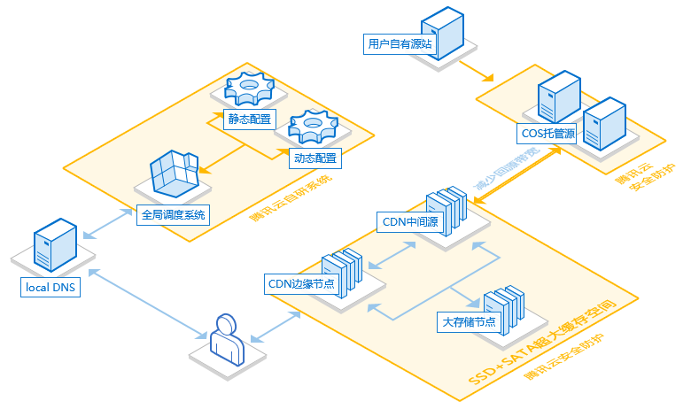
2.3 User and Application access layer design based on Tencent Cloud services (continued)
CDN Caching Architecture
Permanent storage
High-Speed origin-pull linkage
Storage capacity of 1 PB
Linkage bandwidth of 200 Tbps
Accurate scheduling based on customer IP
FLV and HLS live streaming support
Notes:
Tencent Cloud CDN has deployed 1,100+ acceleration nodes across China, covering major operators such as China Mobile, China Unicom, and China Telecom. The total node bandwidth is 80T+, and the reserved bandwidth is 120T+, which perfectly solves the problems of access delay and instability caused by multiple factors such as network performance.
Tencent Cloud CDN provides 200+ overseas nodes, covering 50+ countries and regions around the world, supporting your business to go overseas seamlessly.

Slide 16
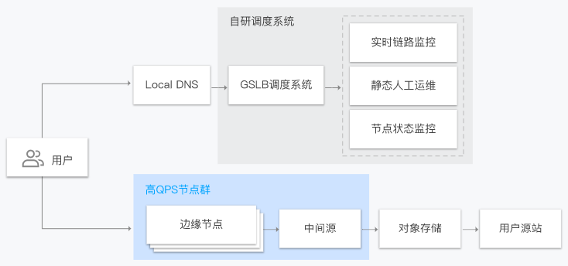
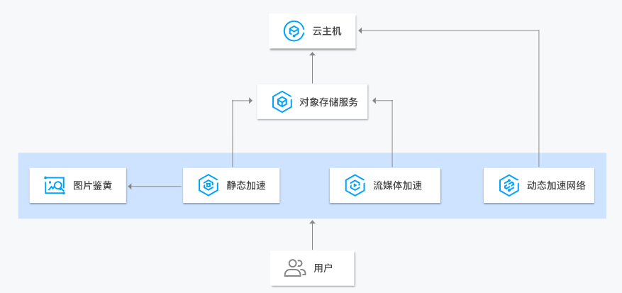
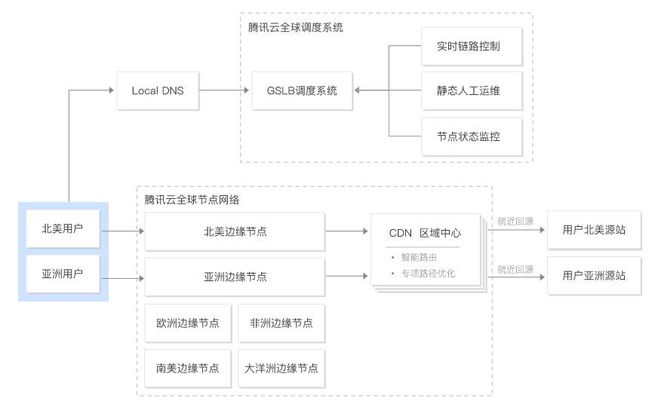
2.3 User and Application access layer design based on Tencent Cloud services (continued)
Static content acceleration
Dynamic content acceleration
Acceleration scenarios
SCDN
Global acceleration
Notes:
Static acceleration：
Website Acceleration: static content (such as web page styles, pictures, small files), e-commerce, UGC
Download Acceleration: CDN provides stable and high-quality download acceleration for downloading (game installation package, mobile phone ROM upgrade, and application package)
Audio and Video acceleration: For online audio and video playback, our CDN ensures high service availability and media transmission speed, and providing a smooth viewing experience
Dynamic Acceleration：
You can use CVM to carry the computing logic of the server, and use the powerful global dynamic acceleration capability of DSA to transfer user requests from all over the world to the Origin Server at a high speed.
Global Acceleration：
Provides static, download, audio and video and other acceleration business and overall solutions. Tencent self-built GSLB global scheduling system, user requests accurately dispatched to the optimal overseas acceleration node; Tencent Cloud Global Acceleration Network adopts the two-level architecture of edge node and regional center, and further enhances the acceleration effect through intelligent routing and special path optimization between nodes.
Secure Acceleration：
The user requests to reach the secure acceleration network, and each secure node loads a customized precise access control policy, and only requests for access by matching rules are allowed. Distributed high-defense cleaning nodes perform DDoS attack cleaning, and WAF clusters perform website security protection inspections to block malicious requests from reaching customer origin sites

Slide 17
2.3 User and Application access layer design based on Tencent Cloud services (continued)
Tencent Cloud DNS:
As a new-gen high-performance DNS server program, Tencent Cloud DNS provides stable DNS services that are over 100 times faster than mainstream DNS resolutions.
Tencent Cloud DNS enjoys protective services offered by Tencent Cloud Anti-DDoS, utilizes multiple patented algorithms, and features 200 Gbps DNS attack protection capabilities, making it an ideal choice for website security protection in the era of big data.
HTTPDNS:
Its access nodes cover top 17 Chinese ISPs, Southeast Asia, and North America and enable accurate resolution and fast access;
It accurately identifies the sources of requests and directs access to the most accurate node;
It features 1-IP-3-region clustered failover, delivering automated failover in seconds and an SLA of over 99%;
It bypasses the local ISP DNS, helping avoid hijacking and DNS contamination.

Slide 18
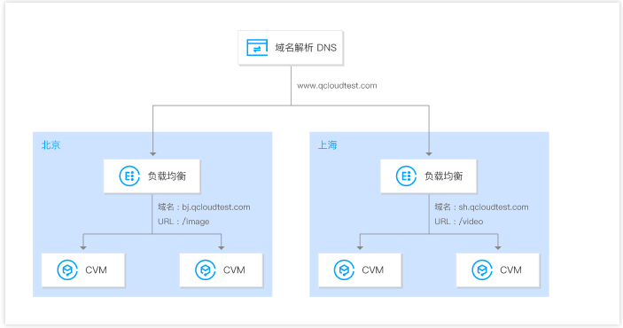
2.3 User and Application access layer design based on Tencent Cloud services (continued)
Diversion of traffic to multiple regions:
It involves globally resolving the business traffic to CLB instances in multiple regions, guaranteeing multi-site active-active or disaster recovery and reducing the load stress on servers in individual regions.
Notes:
Global Load Balancing
Using Tencent Cloud DNS, HTTPDNS to resolve request traffic to multi-regional CLB instances to implement Active-Active and remote DR across regions.
AnyCast CLB
CLB supports creating Anycast CLB instances. Anycast CLB is a load balancing service that supports cross-region dynamic acceleration. CLB VIP is published in multiple regions. The client connects to the nearest POP and forwards traffic to a CVM instance through the high-speed internet of Tencent Cloud IDC.
You can deploy CLB instances in different regions and bind them to CVM instances in corresponding regions.
You can use Tencent Cloud DNS to resolve domain names to the CLB VIP in each region.
Business traffic will be forwarded to multiple CVM instances in multiple regions via DNS and CLB, achieving global load balancing.
When a region becomes unavailable, you can suspend resolution of the CLB VIP in that region to ensure that your business is not affected.

Slide 19
2.3 User and Application access layer design based on Tencent Cloud services (continued)
CLB
Real server
CLB assigns access requests to different real servers based on the scheduling algorithm:
Weighted round-robin algorithm
Weighted least-connection algorithm
Source hashing scheduling algorithm
Notes:
How load balancing distributes access requests to back-end servers can be set by algorithms. The algorithm used by Tencent Cloud CLB is as follows：
加权轮询算法 （Weighted Round-Robin Scheduling）
加权最小连接数算法（Weighted Least-Connection Scheduling）
源地址散列调度算法（ip_hash）

Slide 20
2.3 User and Application access layer design based on Tencent Cloud services (continued)
CLB performance metrics:
TPS and maximum number of concurrent connections
QPS and throughput
Performance of CLB in handling peak traffic:
A single CLB cluster can provide over 120 million connections and respond to hundreds of millions of web access requests.
A single CLB cluster can handle a peak traffic of 40 GB/s with up to 6 million PPS (packets per second).
CLB strictly isolates the traffic of each tenant and provides active protection against DDoS attacks. When your service is under DDoS attack, CLB will provide free defense against 2–10 GB of attack traffic.
If you have higher protection requirements, you can consider Anti-DDoS Pro, which helps defend against up to 300 GB of attack traffic.
Notes:
CLB performance is evaluated mainly based on several metrics:
TPS (connection per second): the number of TCP connections created by a CLB instance per second.
Maximum number of concurrent connections: the maximum number of connections that a CLB instance can sustain at the same time.
QPS (query per second): also known as request per second (RPS). It is the number of GET, POST, and HEAD packets sent by the client to the HTTP service after a connection is established.
Throughput: the total traffic/bandwidth supported by a CLB instance.

Slide 21
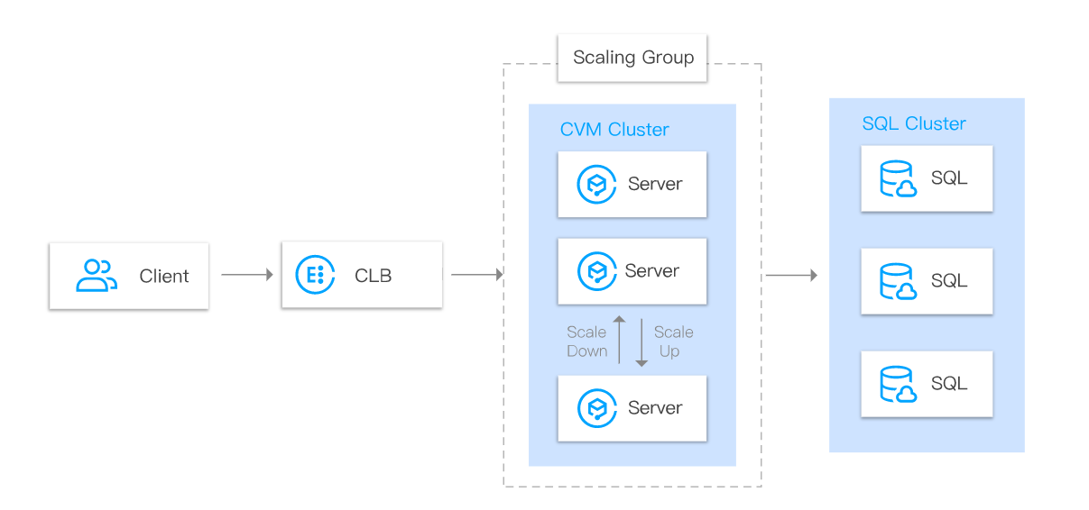
2.3 User and Application access layer design based on Tencent Cloud services (continued)
Peak traffic distribution and elimination of single point of failure:
Distribute traffic of businesses that face high numbers of access requests among multiple CVM instances through CLB;
When some CVM instances become unavailable, CLB will automatically block them to guarantee the proper functioning of the application system.
Notes:
You can use CLB to distribute business traffic to multiple CVM instances.
Client accesses CLB.
Multiple CVM instances form a high-performance and high-availability service pool, to which CLB forwards the business traffic.
When one or more CVM instances become unavailable, CLB can automatically block them and distribute the requests to normal CVM instances.

Slide 22
2.3 User and application access layer design based on Tencent Cloud services (continued)
Horizontal scaling to share peak traffic:
Horizontally scale the service capacity of the application system based on business needs, which is suitable for web servers and application servers.
Notes:
Horizontal Scalability
With Auto Scaling (AS), CLB can automatically create and release CVM instances based on real demands.
We configure auto scaling policies to manage the number of CVM instances, deploy the instance environment. CLB can automatically add CVM instances when demands peak, and removing CVM instances when demands drop to reduce costs.
For example, during major sales campaigns in ecommerce such as Black Friday, web traffic may suddenly increase by 10 times and lasts only for a few hours. In this case, CLB and AS can be used to maximize IT cost savings.

Slide 23
2.3 User and Application access layer design based on Tencent Cloud services (continued)
CLB best practices (link):
Enable the gzip feature to compress webpages to effectively reduce the amount of data transferred over the network and increase the access speed of the client browser.
Enable SSL certificate termination on CLB to increase the user access efficiency;
For non-persistent connection scenarios, use the Weighted Round-Robin algorithm for CLB to increase the user access efficiency;
For processing time-varying requests , use the Weighted Least-Connection algorithm for CLB to increase the user access efficiency;
Notes:
For public network CLB, Gzip compression is enabled for HTTP and HTTPS protocols by default. Gzip features compresses websites, which effectively reduces data volume in network transmission and speeds up access of client browser.
CLB uses the certificate to terminate the connection and then decrypt requests from clients before sending them to the app servers
CLB Algorithm comparison reference：https://cloud.tencent.com/document/product/214/5371
[Weighted round-robin] is simple and stateless, but is not suitable for use cases where the processing time of each request varies significantly. In these scenarios, round-robin scheduling may distribution among servers.
WLC is suitable for scenarios where the time used cause imbalance of load by each request on the backend varies greatly, such as FTP.

Slide 24
Section 3. Handling Traffic Peak at Web and Service Layer
Section 1. Evolution of Cloud Computing
3.1 Challenges of traffic peak at the web and service layer
CONTENTS
3.2 Handling traffic peak at the web and service layer
3.3 Web and service layer design based on Tencent Cloud services

Slide 25
3.1 Challenges of traffic peak at the Web and Service layer
Resource bottlenecks
Limited bandwidth/processing capacity of the server itself
Crashing failures
Unplanned traffic surges
Resource allocation
Big differences between peak and off-peak hours, causing resource waste during idle time
Resource skew, where key resources are used for non-critical businesses

Slide 26
3.2 Handling traffic peak at the Web and Service layer
Service layer:
Cluster + CLB + AS
Minimum availability principle: core functions are available, quick access, and quick completion
Place messages in a queue to buffer the request traffic
Business Logic: filter out invalid requests
In scenarios such as red packet grabbing and flash sales, where most of the traffic is generated by invalid requests, filter it out so that it will not be passed to the server
Implement measures at the business logic such as adding verification code to address instantaneous peak
Notes:
In the cloud, you can monitor demand and workload utilization, and automate the addition or removal of resources to maintain the optimal level to satisfy demand without over- or under-provisioning. There are still limits, but some quotas can be controlled and others can be managed

Slide 27
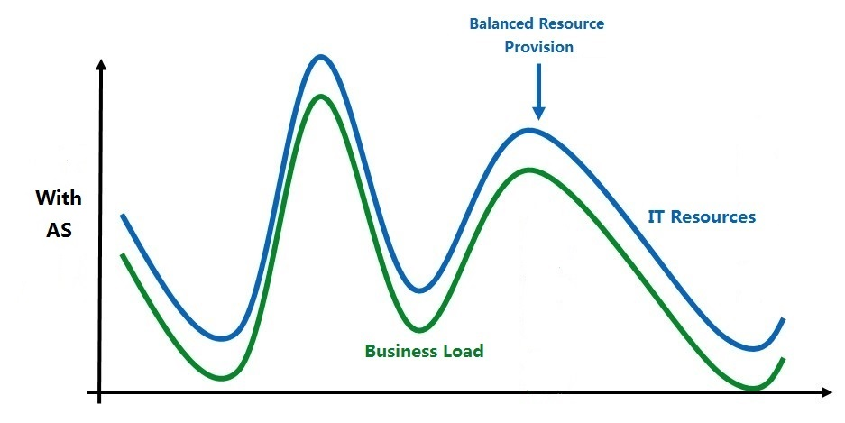
3.3 Web and Service layer design based on Tencent Cloud services
AS:
Auto Scaling (AS) automatically adjusts CVM computing resources based on the business needs and policies and ensures that there are an adequate number of CVM instances to sustain the application load.
Review of core concepts:
Scaling group
Launch configuration
Scaling policy
Cooldown period
Notes:
Scaling group contains a collection of CVM instances that follow the same policies and have a shared purpose. Scaling groups define attributes such as the maximum and minimum numbers of CVM instances in the group and their associated CLB instances.
A launch configuration is the template for the automatic creation of CVMs. It contains the image ID, CVM instance type, system disk/data disk types and capacities, key pair, security group, etc.
When a scaling group is created, it must be specified and cannot be edited once created.

Slide 28
3.3 Web and Service layer design based on Tencent Cloud services (continued)
Peak traffic handling for web applications:
Client requests are routed to the application servers through CLB, and when the number of access requests changes rapidly, AS automatically scales the number of application servers based on the number of requests.
Suitable for: ecommerce websites, video websites, online education, etc.

Slide 29
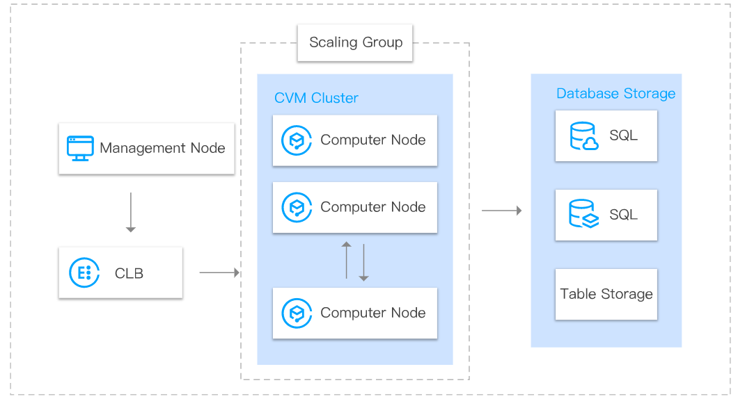
3.3 Web and Service layer design based on Tencent Cloud services (continued)
High-Performance computing clusters for traffic handling:
Adjust the number of servers in the cluster in real time according to the amount of computation.
Suitable for: backend computing clusters such as distributed big data computing nodes and data retrieval servers.

Slide 30
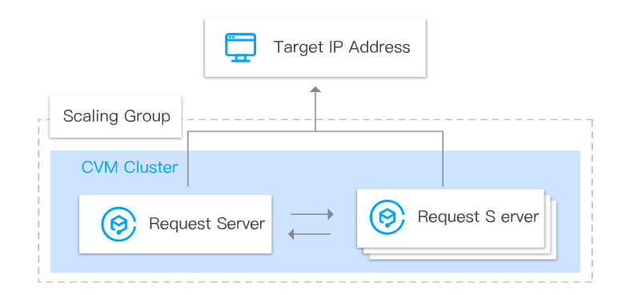
3.3 Web and Service layer design based on Tencent Cloud services (continued)
Peak traffic handling for request servers:
As this type of business has high requirements for timeliness, you can use AS to quickly create and remove request servers.
Suitable for: Server clusters that send requests or collect data.

Slide 31
3.3 Web and Service layer design based on Tencent Cloud services (continued)
[Summary] Features and best practices of AS:
AS can handle business traffic surges at low costs, and its health check feature enables it to automatically replace unhealthy CVM instances;
If a cluster in the auto scaling group needs to accept requests from CLB, and the instances in the cluster require public network access at a fixed IP, we recommend you set a fixed IP for the egress of the auto scaling group;
Most websites have peak periods of less than 8 hours in total per day, and for the remaining 16 hours, we recommend you scale in idle servers, i.e., combining fixed servers and scalable servers;
We recommend you set automatically scalable instances to start services automatically upon startup without manual intervention required throughout the process.
Notes:
This solution is applicable when clusters in your scaling group have the requirements:
To initiate outbound access
To use a static public IP address for outbound access
Add the CVM to the VPC subnet and direct the route table to the NAT Gateway so that all outbound access requests are delivered via the public IP address of the NAT Gateway and set the network attribute of the scaling group to use this subnet
/etc/rc.d/rc.local
为伸缩组设置固定出口IP：https://cloud.tencent.com/document/product/377/8779
设置服务自启动：https://cloud.tencent.com/document/product/377/8697

Slide 32
3.3 Web and Service layer design based on Tencent Cloud services (continued)
Benefits of the Business Decoupling to peak traffic handling:
The business system and the database are deployed separately, which prevents both from competing for resources while increasing availability;
The business system can be further split into microservices for flexible deployment;
A decoupled business system is more flexible and scalable than a tightly coupled one during business peak;
A decoupled business system is developed, tested, and deployed independently, making it easier to improve the access efficiency by optimizing the code structure.
Notes:
And the last topic of App/Service Layer, Business Decoupling (loosely-coupling design). Why do we want business decoupling?
This is a design concept, involving multiple cloud components.

Slide 33
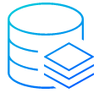
3.3 Web and Service layer design based on Tencent Cloud services (continued)
Tencent Cloud services that support business decoupling
CLB
CMQ
API Gateway
SCF
TencentDB for Redis
TSF
TKE
Notes:
The content of business decoupling, application design and management on the cloud has been covered, so I won’t repeat it here.

Slide 34
Section 4. Data Cache Architecture Design
Section 1. Evolution of Cloud Computing
4.1 Overview of data cache architecture
CONTENTS
4.2 Data cache architecture for handling peak traffic
4.3 Cache design based on Tencent Cloud services

Slide 35
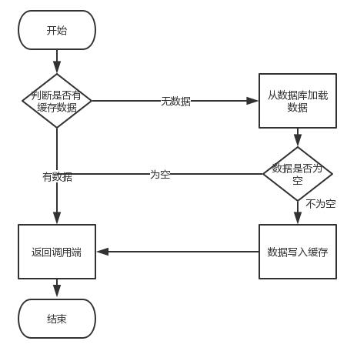
4.1 Overview of Data Cache Architecture
Data Cache Architecture:
Application server
Primary
Browser
CLB
Application server
Cache
Cache application architecture
Processing logic
Notes:
Cache architecture：
The figure shows Web Browser accessing data when there is a cache.
When the browser requests data from the Application Server through the load balancer, the App Server reads the data from back-end database, and first reads the data from the cache, if there is data in the cache, the data is directly returned to the application server, and then returned to the browser; if there is no data in the cache, the cache will request to load the data from the main database, if the request finds that the data in the main database is also empty, Then return to the application server, and respond to the browser with empty data. If there is data in the main database, first write the data to the cache, and then return the data to the calling server, and return to the browser

Slide 36
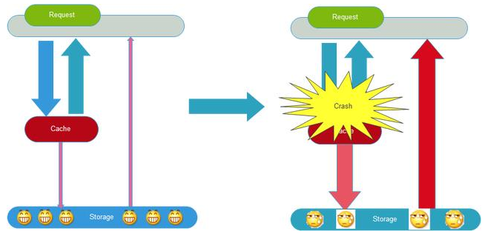
4.1 Overview of Data Cache Architecture (continued)
Cache Avalanche:
After a large number of nodes in a Redis cluster fail, many requests will turn to the MySQL database, and the number of calls to MySQL will surge and exceed the threshold or even cause MySQL to fail. As many application servers rely on the services of MySQL and Redis, this will soon evolve into an avalanche of failures on the servers until the website eventually crashes completely.
Notes:
To provide better cache design in large systems, some problems may need to be considered first: Cache penetration,
Cache avalanche refers to a scenario where large number of data in the cache expired at the same time or the Cache service is down, and all of a sudden, all searches of these data will hit DB and cause high load to the DB layer and impact the performance.

Slide 37
4.2 Data cache architecture for handling peak traffic
Cache Avalanche prevention:
High Cache Availability
Cache Backup and Restoration
Cache Downgrading
Cache Prefetch
Drill
Notes:
To mitigate the problem, some methods can be adopted.
Using clusters to ensure that some cache server instance is in service at any point of time. For Redis, we can have Redis Clusters.
You can cache data by category and add different cache times
Add a random number to the cache time, so that all caches will not fail at the same time
HA
To prevent Redis service failures, we leverage the HA master-slave architecture of Redis, and also implement the persistence of Redis (Snapshotting). In the case of server restart, Redis will load the data from a backup file and put them into memory.
Snapshotting: Redis by default stores snapshots of data in dumb.rdb file. In the case of server restart, Redis will load the data from a backup file and put them into memory.
Cache Downgrading：
You can use local caches such as eh-cache (temporary support), but the main thing is to limit the source service access, resource isolation (fuse), and downgrade. When the number of visits increases sharply, the system can be automatically degraded based on some key data, or it can be configured with switches to achieve manual degrading, which will involve operation and maintenance cooperation
Cache Prefetch
Fast cache warm-up
It is recommended to simulate the application’s load conditions and possible problems before the project goes live, after the cache layer goes down, preview the HA and find the problems in advance.

Slide 38
4.3 Cache design based on Tencent Cloud services
TencentDB for Redis
TencentDB for Redis is highly available, reliable, and elastic and has various features such as cluster deployment, data backup and restoration, and prefetch.
Peak traffic handling capacity:
TencentDB for Redis offers a choice of 0.25 GB–4 TB capacity specifications available in Standard and Cluster Editions;
The Standard Edition has a performance of up to 100,000+ QPS, and the Cluster Edition supports tens of millions of QPS. Their ultra-high performance can perfectly meet the needs in most business scenarios ranging from gaming, mobile apps to advertising and ecommerce;
An instance can be scaled quickly in the console without having to stop the services. No operations are required at your side;
TencentDB for Redis adopts a master/replica hot backup architecture. In case of failure of the master, the access can be switched to the replica in a matter of seconds. The switch process does not affect the online business, nor does it require any operations at your side, reducing the labor and time costs of developing a master/replica system architecture.
Notes:
Tencent Cloud Redis supports a maximum storage capacity of 4TB and tens of millions of concurrent requests, which can meet business needs in different scenarios such as caching, storage, and computing.

Slide 39
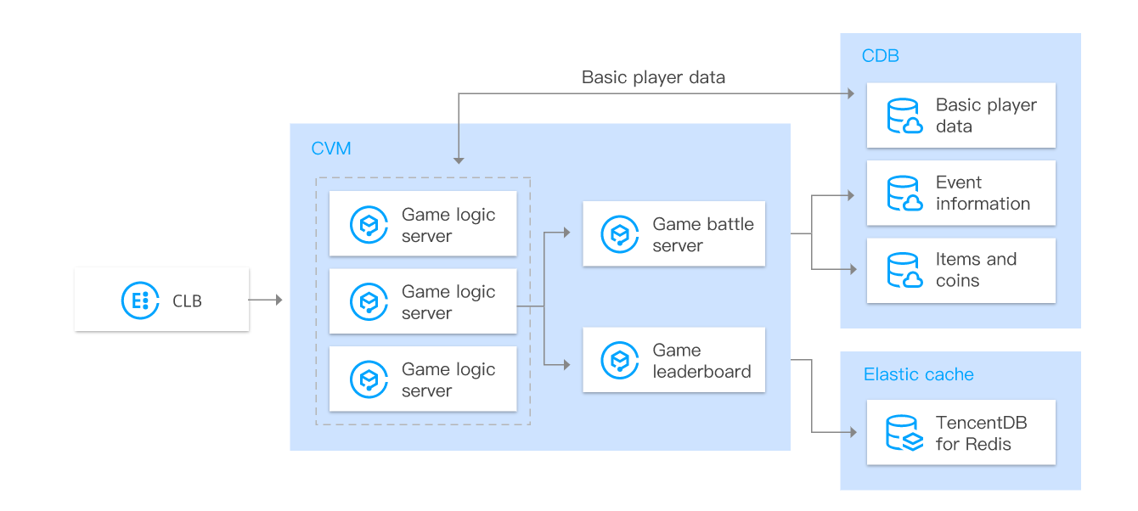
4.3 Cache design based on Tencent Cloud services (continued)
High concurrency - gaming scenarios:
You can store non-character data such as leaderboard data in TencentDB for Redis for fast access. The "Sorted Set" data type built in Redis can help you sort player data.
Notes:
The 3 common use cases are:

Slide 40
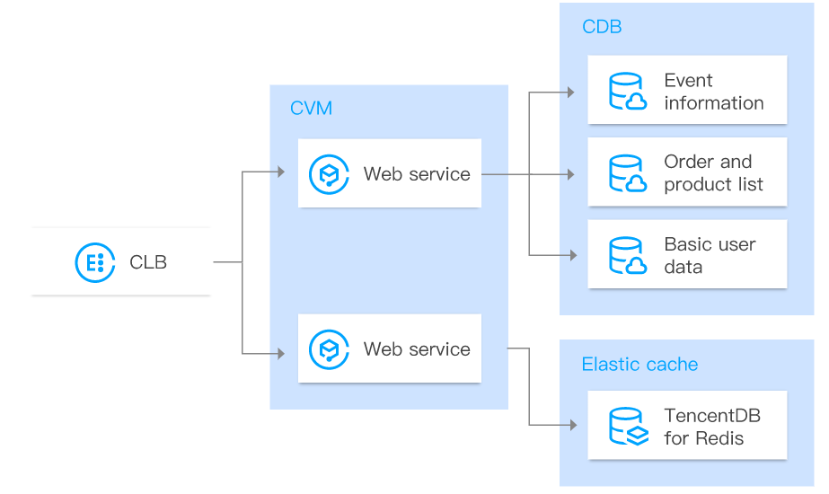
4.3 Cache design based on Tencent Cloud services (continued)
High concurrency - internet and application scenarios:
For internet and application businesses, you can use TencentDB for Redis to cache basic user information for higher read performance and cache static images and resources for faster application loading.

Slide 41
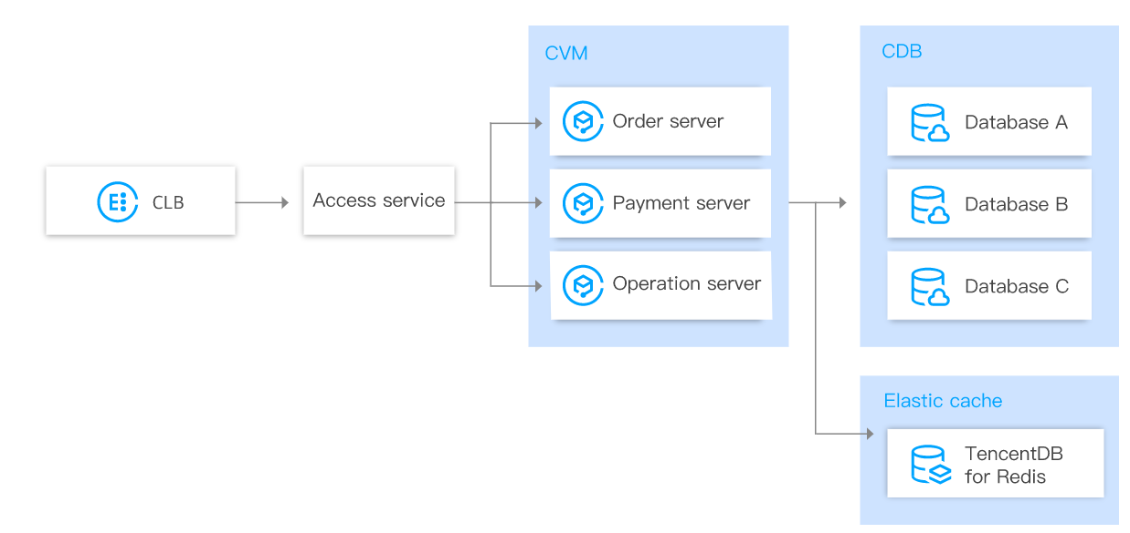
4.3 Cache design based on Tencent Cloud services (continued)
High concurrency - ecommerce display scenarios:
You can store data of product images and recommendations in TencentDB for Redis for fast access, and its processing capacity of tens of millions of QPS can easily handle high numbers of concurrent access requests made during promotions, (i.e., flash sales).

Slide 42
Section 5. Async Message Queue Architecture Design
Section 1. Evolution of Cloud Computing
5.1 Overview of async message architecture
CONTENTS
5.2 Async message architecture for handling peak traffic
5.3 Async message architecture based on Tencent Cloud services

Slide 43
5.1 Overview of async message architecture
Message queue:
It is a container that stores messages and is essentially a queue;
Use cases:
Async processing
Application decoupling
Traffic peak shifting
Log processing
Messaging
Notes:
Message Queue is a communication method between applications. There is a message system to ensure reliable delivery of information. Message publishers only need to publish messages to MQ regardless of who gets them. Messages are used The publisher only takes the message from MQ regardless of who published it, so that the publisher and the user do not need to know the existence of each other.
Producer：Message producer is responsible for generating and sending messages to Broker;
Broker：Responsible for message storage, confirmation, retry, etc. Generally, it will contain multiple queue；
Consumer：is responsible for obtaining messages from the Broker, and processing them accordingly
Message queue characteristics：
Asynchrony: The time-consuming synchronous operation is processed asynchronously by sending messages. Reduced synchronization waiting time。
Loose Coupling: The message queue reduces the coupling between services. Different services can communicate through the message queue without worrying about each other's implementation details, as long as the message format is defined.
Distributed: Through the horizontal expansion of consumers, the risk of message queue congestion is reduced, and the possibility of a single point of failure for a single consumer (of course, the message queue itself can also be made into a distributed cluster)
Reliability: The message queue generally stores the received message on the local hard disk (when the message is processed, the storage information is implemented according to different message queues, and it may be deleted), so that even if the application hangs or the message queue itself Hang up, the message can be reloaded.

Slide 44
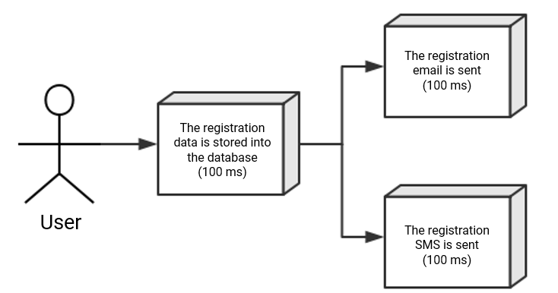
5.1 Overview of async message architecture (continued)
Messaging middleware communication process:
Sequential Processing:
Parallel processing:
Notes:
Scenario description: After registering, app needs to send a registration email and registration SMS：
Sequential Processing: After the registration information is persisted, the registration email is sent, and then the registration SMS is sent. After all three services are completed, return to the client；
Parallel processing: After the registration information is persisted, the registration message is sent at the same time as the registration email. After all three services are completed, they are returned to the client. The difference with sequetial is that the parallel method can improve the processing time.
Assuming that each of the three business nodes uses 100 milliseconds, regardless of overheads, the sequential mode time is 300 ms, and the parallel time may be 200 milliseconds. The serial mode can process 3 requests within 1 second, and the parallel mode can process 5 requests within 1 second. In summary, the performance (concurrency, throughput, response time) of the traditional system still has bottlenecks. How to solve this problem？

Slide 45
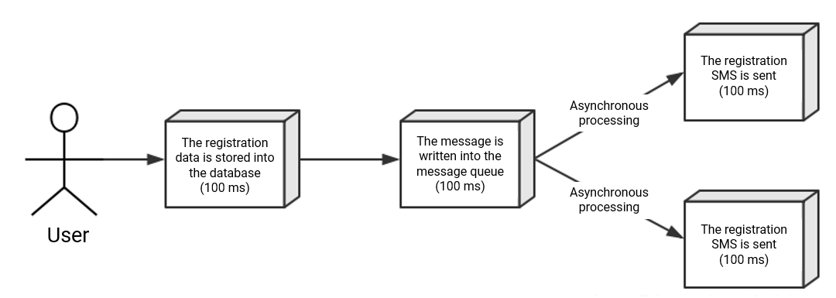
5.2 Async message architecture for handling peak traffic
Async communication process for handling peak traffic:
Async Processing:
The response time is the time it takes to write the registration information to the database and place the message into the message queue, i.e., 105 ms. After the registration email or SMS message is written to the message queue, the request will be returned immediately. This way, after async processing is implemented by the message queue, 9 requests can be processed in one second, thus significantly increasing the system performance.

Slide 46
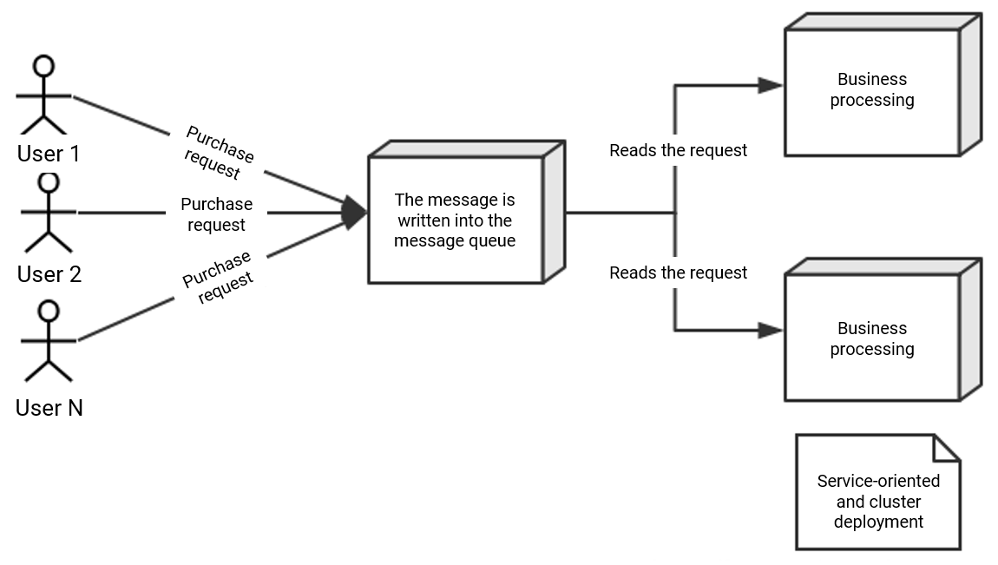
5.2 Async message architecture for handling peak traffic (continued)
Traffic peak shifting process:
Traffic Peak Shifting:
In flash sales, the application system often crashes because it cannot sustain the excessive instantaneous traffic. To solve this problem, we can direct the excessive traffic to the message queue before it flows into our servers; the message queue serves as a buffer.
Notes:
Once you have the order stored in a durable queue, you can have queue workers read the order messages and process them at a rate that will not overwhelm your database servers.

Slide 47
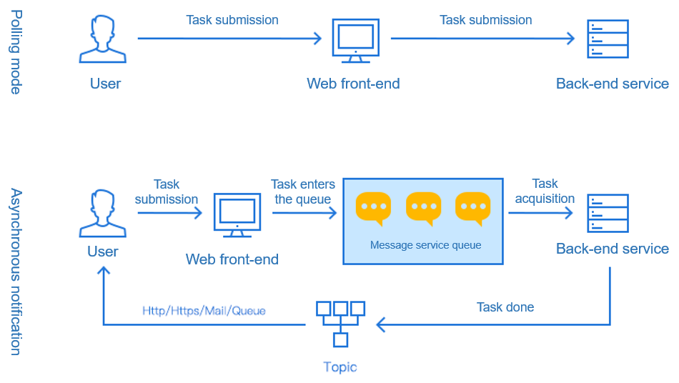
5.2 Async message architecture for handling peak traffic (continued)
Async notification for handling peak traffic:
The traditional approach is that the client repeatedly polls. When the workload is compute-intensive, backend cannot return results quick enough. CMQ can be used to add subscriptions and configured to deliver a notification to the client upon the completion of the computation of heavy logic.

Slide 48
5.3 Async message architecture based on Tencent Cloud services
Tencent Cloud Messaging Middleware Services:
CMQ
Tencent Cloud Message Queue (CMQ) is a distributed message queue service that provides a reliable message-based async communication mechanism. It enables message receiving/sending among different applications deployed in a distributed manner (or different components of the same application) and stores the messages in reliable and valid CMQ queues to prevent message loss.
CKafka
Tencent Cloud CKafka is a distributed, high-throughput, and high-scalability message system, which is 100% compatible with open-source Apache Kafka APIs.
CMQ
CKafka

Slide 49
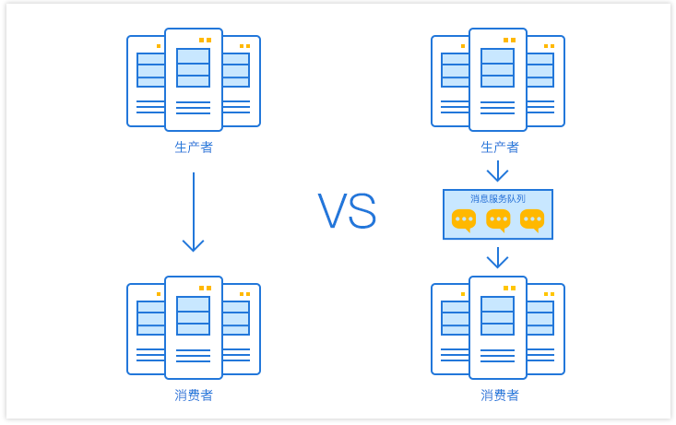
5.3 Async message architecture based on Tencent Cloud services (continued)
System decoupling based on CMQ for handling peak traffic:
CMQ provides an async communication protocol. The message sender can immediately get the returned result after sending a message to CMQ without the need to wait for the recipient's response. The message will be saved in the queue until fetched out by the recipient.
Notes:
Take the IT architecture of e-commerce as an example. In the traditional tightly coupled order scenario, a customer places an order on the e-commerce website (such as buying a mobile phone). After the order system receives the request, it immediately calls the inventory system interface, and the inventory is reduced by one; but There are huge risks in this model：
The order system and the inventory system are strongly coupled. If the inventory system is inaccessible (upgrades, business changes, failures, etc.), the order reduction will fail, which will cause the order to fail；
The traditional solution is to establish a socket connection between the service room and the inventory system through the order system, but if the ip/port of the inventory system is changed, and the receiver of the inventory system is increased, the order system needs to be modified；
A large number of requests in a short period of time, SQL to the inventory system, frequent inventory query, inventory modification, the inventory system is extremely loaded；
User's feelings: the order fails, retry, and still fails, resulting in loss of customers.
Several of these systems work separately to remove strong coupling：
Order system: After the user places an order, the order system completes the persistence processing, writes the message into the message queue, and returns the user's order to be successfully placed. At this point, the customer can think that the mobile phone has been bought. CMQ provides an asynchronous communication protocol. The sender of a message can return immediately after sending the message to the message queue without waiting for the receiver's response. The message will be kept in the queue until it is taken out by the receiver。
Inventory system: Get order information from CMQ, and the inventory system performs inventory operations based on the order information。
In this way, even if the inventory system is down when the user places an order, it will not affect the normal order placement (after the inventory system is repaired, the order will be removed from the CMQ for operation). After the order system is written into the Tencent Cloud CMQ message queue, there is no need to care about other follow-up operations. Realize the application decoupling of order system and inventory system。

Slide 50
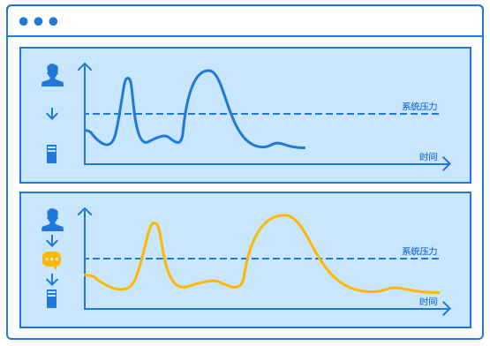
5.3 Async message architecture based on Tencent Cloud services (continued)
Peak shifting based on CMQ for handling peak traffic:
Introducing CMQ to asynchronize the business logics that don't require immediate processing, such as the different logics for receiving service requests, processing requests, and returning requests.
Notes:
Case Study：
A new mobile phone on an e-commerce website is released, and users with an appointment code can purchase the phone first. The appointment method is: register your account to get the appointment code, the appointment is expected to exceed 10 million users。
In IO-latency-sensitive business environments such as double 11-second kill, mobile phone appointment pre-order, when external requests exceed system processing power, if the system does not do the corresponding protection, it may be due to the historical accumulation of time-out request overload caused by the system processing of each request is invalid due to time-out, the system external rendering of the service capacity of 0, and in this case the service can not be automatically restored。
With the introduction of CMQ, when the appointment campaign began, a flood of concurrent visits swarmed in：
All customer appointment requests are returned to the page immediately. Customers can close web pages for other activities. The appointment code is later pushed to the customer's mailbox/mobile phone；
More than 10 million levels of registration, appointment applications, the first temporary existence of Tencent Cloud CMQ message queue cluster；
Back-end services process registration and appointment requests according to the actual select, insert, and update capabilities of the database；
After successful processing, the results are returned to the user. After the appointment is over, the user receives the appointment code at approximately 5-30min.

Slide 51
5.3 Async message architecture based on Tencent Cloud services (continued)
Peak handling capacity of CMQ:
5,000 QPS per CMQ instance and over 100,000 QPS per cluster;
Improved Raft consensus algorithm for guaranteed strong data consistency;
Message rewinding by time;
99.999999% reliability;
Multidimensional security protection and anti-DDoS services.

Slide 52
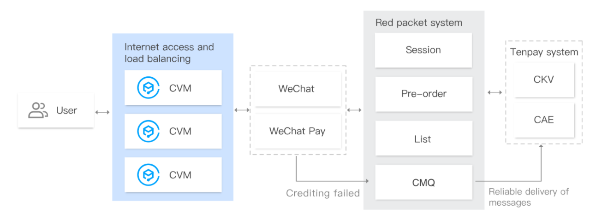
5.3 Async message architecture based on Tencent Cloud services (continued)
On Chinese New Year's Eve, user actions of sending and opening red packets and crediting are all converted into billions of requests. If a traditional transaction method is used, the concurrency pressure will be aggravated and crash the system.
CMQ ensures reliable storage and transfer of red packet messages and can write three copies in real time to avoid data loss. When fund crediting fails, the operation can be retried multiple times so as to avoid disadvantages of traditional methods such as rollback upon failure and frequent database polling.
Notes:
CMQ has been used in the distributed transaction problem of the WeChat Red-Packet system.
The WeChat architecture team has integrated CMQ into the red packet system to reduce its distributed transactions overhead. The CMQ red packet queue ensures the reliable delivery and storage of red packet messages. If the funds fail to be credited, the account system will continue pulling from the CMQ to retry the update operation, ensuring that the crediting message will never get lost and avoiding drawbacks such as rollback upon crediting failure and frequent database polling.

Slide 53
5.3 Async message architecture based on Tencent Cloud services (continued)
In the customer's promotion system, consumer crediting is async. The credit information will be first written to a message queue and then pulled by the consumer. After the consumer confirms that the message is successfully consumed, the callback API will delete the message from the queue.
Major systems such as OPS, alarming, and operations generate massive volumes of logs. The logs will be first aggregated into CMQ, and the backend big data analysis clusters will continuously pull them out of CMQ and analyze them based on the processing capabilities. CMQ can theoretically retain an unlimited number of messages, bringing you complete peace of mind when using it.
Notes:
High Scalability:
The CMQ backend cluster is transparent and transparent to the user; CMQ controller can schedule and relocate queues according to the load of the cluster. If the request volume of a queue exceeds the service threshold of the current cluster, the controller can distribute the queue routes to multiple clusters to increase the number of processable concurrent requests. In theory, CMQ can achieve unlimited message retention and extremely high QPS, enabling you to easily cope with your ever-changing business needs.

Slide 54
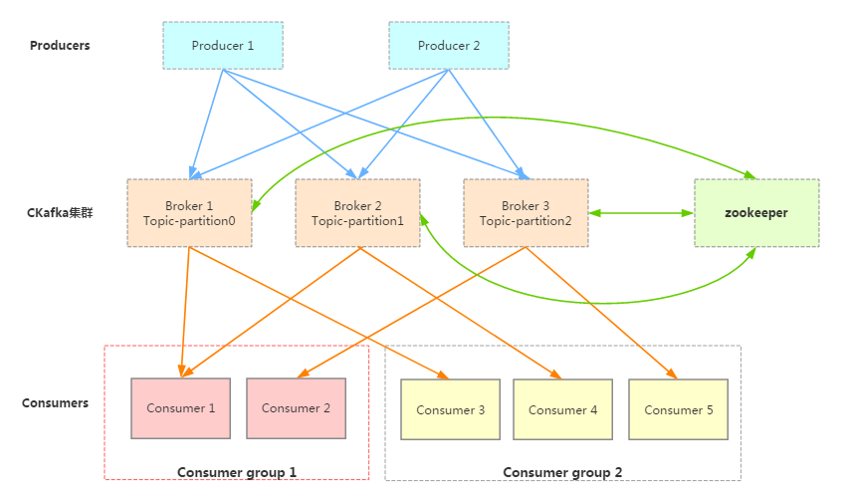
5.3 Async message architecture based on Tencent Cloud services (continued)
CKafka Architecture:
Notes:
A software architect who deals with various microservice-based systems often faces the question, “Should I use Kafka or RabbitMQ?”. Due to some reasons, many developers consider these technologies as exchangeable. Although this is right for some cases, there are some principal differences between these platforms. In this Kafka vs RabbitMQ article, we will look at those principle differences.
So, let’s begin with understanding what exactly is Kafka and RabbitMQ?
Kafka vs RabbitMQ - Which One is Better?
Architecture
Sources
Push/Pull Model
Message Routing
Message Retaining
What is Kafka?
Kafka is a distributed sub/pub message system. It was released in 2011, and it acts as middleware storage between two applications. Producer stores and writes messages in the Kafka cluster. On the other side, the Consumer consumes the messages from the cluster.
Kafka uses the Pull model where consumers make message requests
Kafka retains all the messages by design till a configured timeout per topic, This allows us to replay messages
Based on the open-source Apache Kafka message queuing engine, Tencent Cloud Kafka (CKafka) is a managed, improved Kafka service, It is 100% compatible with the APIs of Apache Kafka v0.9, v0.10, v1.1, and v2.4. And CKafka can integrate with other Tencent Cloud services such as COS and EMR.
CKafka effectively decouples the relationship between message producer and consumer, Producer may be information such as messages generated by web activities, service logs, etc. Producers publish messages to Cloud Kafka's Broker cluster, CKafka can guarantee the order of messages in a partition.
We can use Kafka as a Message Queue or a Messaging System but as a distributed streaming platform Kafka has several other usages for stream processing. Kafka is widely used in big data scenarios, such as webpage tracking, behavior analysis, log aggregation, monitoring, streaming data processing, and online and offline data analysis
The cluster manages the cluster configuration through Zookeeper
Consumer is divided into several Consumer Groups. Consumers consume messages from Broker by pulling messages.
3 common use cases are:

Slide 55
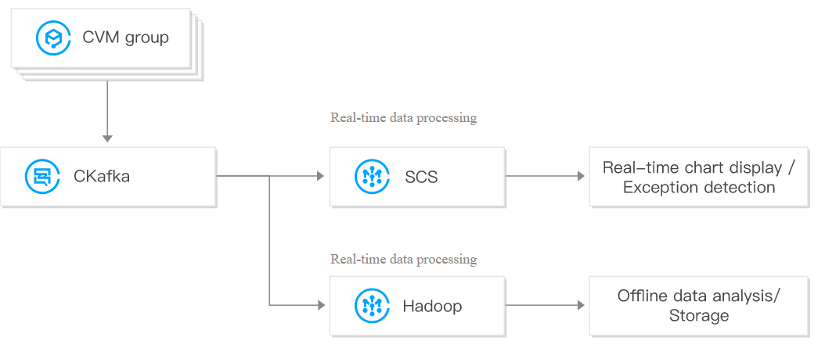
5.3 Async message architecture based on Tencent Cloud services (continued)
CKafka for handling high-concurrent Big Data processing scenarios:
CKafka can be used in combination with SCS for real-time/offline data processing and exception detection to meet the needs in different scenarios:
It analyzes and displays real-time data and detects exceptions to quickly identify system issues.
It stores consumed data in disks, analyzes it offline, and processes it again to generate trend reports.
Notes:
CKafka can be used together with Stream Compute Service (SCS) for real-time/offline data processing and exception detection:
Real-time data is analyzed and displayed and exceptions are detected to quickly locate system issues.
Historical consumption data is stored and analyzed offline for secondary data processing and trend report generation
In some big data-related business scenarios, a large amount of concurrent data needs to be processed and aggregated. At this time, the processing performance and scalability of the cluster have high requirements. CKafka's implementation of the data distribution mechanism, disk storage space allocation, message format processing, server selection, and data compression also determines that it is suitable for processing massive real-time messages, and can summarize distributed application data, which is convenient System operation and maintenance.
In specific big data scenarios, CKafka can support the processing of offline data and streaming data, and can easily perform operations such as data aggregation and analysis.

Slide 56
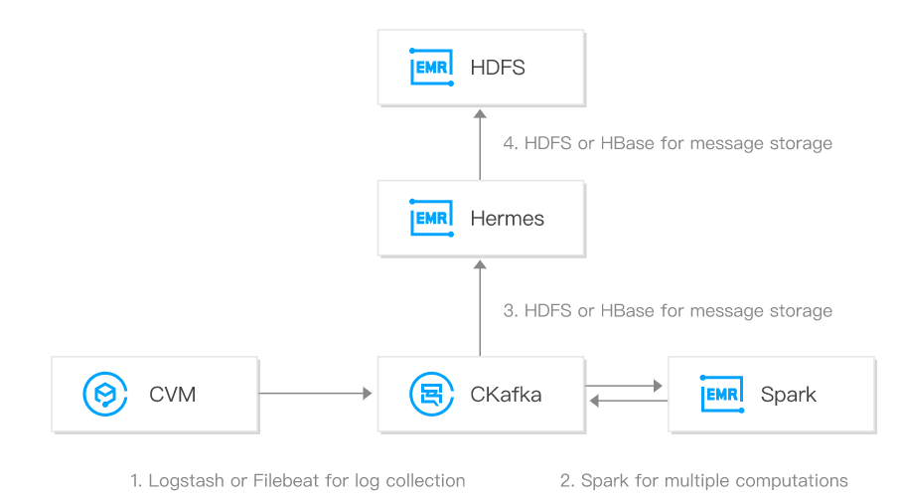
5.3 Async message architecture based on Tencent Cloud services (continued)
Log aggregation capabilities of CKafka:
CKafka can be combined with EMR to build a complete log analysis system. The Agent deployed on the client first collects logs and aggregates the data into CKafka. Then, backend big data suites such as Spark compute and consume data multiple times and clean up raw logs for storage in disks or graphical display.
Notes:
CKafka can work seamlessly with EMR to build a complete log analysis system. Logs are first collected by the agent deployed on the client, and the data is aggregated to CKafka. The data is then computed and consumed multiple times by the backend big data suite such as Spark, and the original logs are cleaned, stored or graphically displayed.
Compared with a centralized log aggregation system, CKafka can achieve stronger durability guarantees and lower end-to-end latency while providing the same performance.
The characteristics of CKafka determine that it is very suitable as a "log collection center"; multiple servers/applications can send logs to the CKafka cluster in "batch" and "asynchronously" without storing them locally or in the DB; CKafka can submit messages/compress messages in batches. At this time, consumers can make Hadoop and other systematic storage and analysis systems perform statistical analysis on the pull logs.

Slide 57
5.3 Async message architecture based on Tencent Cloud services (continued)
High processing performance of CKafka:
General performance: million-level QPS
High throughput
99.95% availability

Slide 58
Section 6. Handling Traffic Peak at Data Layer
Section 1. Evolution of Cloud Computing
6.1 Overview of the data layer for peak traffic handling
CONTENTS
6.2 Data layer design for handling peak traffic
6.3 Data layer architecture based on Tencent Cloud services

Slide 59
6.1 Overview of the data layer for peak traffic handling
Surges in business data volumes in the era of big data
High numbers of concurrent business requests
As the underlying core of applications, the data layer is crucial to latency, response time, performance, and user experience
Traditional databases OLAP + OLTP + database sharding and table splitting scheme
Performance bottlenecks
Costly storage of historical data
Database sharding and table splitting scheme and data skew
Significant impact of scaling on businesses
Increased storage costs caused by the separation of OLAP from OLTP
High business transformation costs and proneness to errors during data sync
Notes:
Faced with the number of users of Internet-related services, the stand-alone database becomes a bottleneck in terms of access capacity, and disaster tolerance due to the limitations of hardware and software. Even with physical hardware is upgraded to dozens of CPUs, with a dat volume of TB, the performance of DDL and DML will drop sharply;
E-commerce, finance, O2O, social applications, retail, and SaaS service providers generally have problems such as large user bases (millions or more), frequent marketing activities, and slower response of core transaction system databases
In the IOT use case, such as industrial monitoring and remote control, the extension of smart cities, smart homes, and the Connected Vehicles, there are many sensing and monitoring devices. Usually the data stored for a year can reach the petabyte or even the EB level.
In order to support large-scale data storage and high-concurrency database access, government agencies, large enterprises, banks and other industries rely heavily on minicomputers and high-end storage. Internet companies can achieve the same or even higher capabilities of commercial databases that can be achieved through low-cost x86 servers and open source software.

Slide 60
6.2 Data layer design for handling peak traffic
Database sharding and table splitting
Primary/Secondary sync + read/write separation
Separation of dynamic data from static data
Use of static storage, cache, and other media to provide services
Distributed database architecture
Automated sharding for reduced impact on businesses;
Hierarchical storage of large/small customers' data and frequent/infrequent data.
Online linear scaling for smooth cluster scale-out in response to business growth.
Notes:
When processing large amounts of data "read requests" are under heavy pressure and high requirements, the read pressure can be distributed to each slave node through the read-write separation function.
The basic principle of read-write separation is to let the master node (master) handle transactional add, modify, and delete operations (INSERT, UPDATE, DELETE), and let the slave node (slave) handle query operations (SELECT).

Slide 61
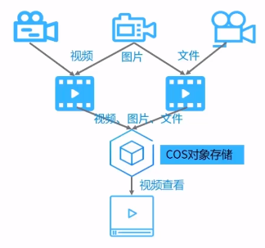
6.3 Data layer architecture based on Tencent Cloud services
COS: Distributed storage service provided by Tencent Cloud for storing a high number of files. It offers different storage classes for different access frequencies: STANDARD storage, STANDARD_IA storage, and ARCHIVE storage. COS has the following features:
High data persistence
Fully symmetrical system architecture
Unlimited scalability
No single points of failures
Simplicity and reliability

Slide 62
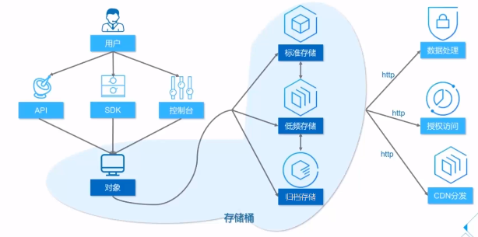
6.3 Data layer architecture based on Tencent Cloud services (continued)
Basic storage architecture of COS:
Notes:
COS can be accessed through various methods such as console, API, SDK, and tools. Multiple file formats can be uploaded, downloaded and managed through COS. Global CDN nodes can also accelerate file downloads.
Standard storage
Applicable scenarios: hot videos, social pictures, mobile applications, game programs, dynamic websites.
Standard storage provides users with high-reliability, high-availability, and high-performance object storage services.
Standard storage has low access latency and high throughput, so it is suitable for business scenarios with a large number of hot files and frequent data access
Infreq Access
Applicable scenarios: network disk data, big data analysis, government and corporate affairs data, low-frequency files, monitoring data.
Low-frequency storage provides users with object storage services with high reliability, low storage costs and low access latency.
Low-frequency storage keeps the first byte access time at the millisecond level on the basis of reducing the storage price, ensuring that users do not need to wait when retrieving data. High-speed reading, but data acquisition will incur costs, which is suitable for lower access frequencies Business scenario。
归档存储
Applicable scenarios: file data, medical images, scientific data, and video footage.
Archive storage provides users with object storage services with high reliability, extremely low storage costs and long-term preservation.
Archive storage provides the lowest storage unit price, but requires a longer thawing time when reading data, so it is suitable for archived data that needs to be stored for a long time。

Slide 63
6.3 Data layer architecture based on Tencent Cloud services (continued)
Hierarchical storage of frequent/infrequent data and hot/cold data:
Upload the data uploaded by users to COS, store high-frequency data in STANDARD storage class and low-frequency data in STANDARD_IA storage class. In this way, different storage classes in COS will provide services based on user requests in case of business surges. COS features massive storage and high bandwidth traffic, which can be used together with CDN to prefetch the data and push it to the node closest to the user, helping easily responding to high-concurrency scenarios.
Notes:
Whether it is a mobile phone APP, website, or HTML5 page, object storage can provide SDKs in various languages according to the type of application program to achieve seamless access. When business explodes and user-generated content (UGC) increases sharply, object storage will automatically expand according to requests and traffic requirements, and calmly respond to business emergencies. Since UGC usually has time-dimensional access characteristics, object storage can layer data between hot and cold data, using standard storage for hot data, and low-frequency storage for cold data. Cooperate with life cycle rule configuration, switch storage category, effectively reduce storage cost

Slide 64
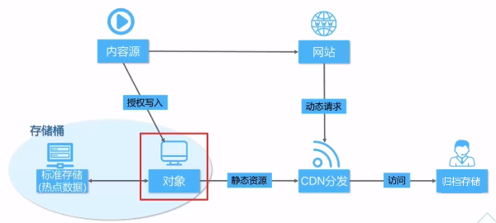
6.3 Data layer architecture based on Tencent Cloud services (continued)
Dynamic/Static data separation for handling high numbers of concurrent requests:
STANDARD storage can store and distribute static resources and features unlimited capacity and high-frequency reads/writes to provide scalable and reliable storage for static resources.
Notes:
Website usually distinguishes between frequently changing and long-term resources in dynamic web pages according to certain rules. Static resources refer to long-term unstructured data resources. Standard storage provides the storage and distribution capabilities of static resources, reduces the pressure on the resource server, and uses the characteristics of unlimited capacity and high-frequency read and write to provide scalable and reliable storage for static resources. Users can host all static content (including audio, video, pictures, and other files) in the website in standard storage, and use Tencent Cloud CDN to distribute the content. Combined with the capabilities of Tencent Cloud CDN global acceleration nodes, hot files can be distributed to edge nodes in advance to reduce access latency.

Slide 65
6.3 Data layer architecture based on Tencent Cloud services (continued)
TencentDB for MySQL:
TencentDB for MySQL is a high-performance distributed data storage service developed by Tencent Cloud based on the open-source MySQL database. It enables you to set up, manipulate, and scale relational databases in the cloud more easily.
Features:
Read/Write separation and read-only instance scalability;
Up to 240,000 QPS per instance and storage capacity of 6 TB;
Protection against DDoS attacks and database attacks;
Data backup and encryption;
Real-Time hot backup and automated disaster recovery.

Slide 66
6.3 Data layer architecture based on Tencent Cloud services (continued)
Source (Master)/Replica Architecture:
A database instance is divided into one read/write master primarily responsible for write operations and several read-only replicas responsible for read operations. This is a typical example of read/write separation.
Service layer
Read/Write source
Read-only replica
Source
Read-only replica
Replication
Replica
Replica
Replica
Notes:
Many systems read far more than write. If the pressure of database read and write is on the same host, this is obviously not reasonable.
Divide a database server into a single write master library (mainly responsible for write operations), and assign the read database pressure to the read slave library, and the read slave library can be changed to multiple，

Slide 67
6.3 Data layer architecture based on Tencent Cloud services (continued)
Data sync consistency:
Read/Write separation introduces the problem of inconsistency between the master and replicas caused by delays (such as network transfer and operation) while improving the efficiency.
Data sync mode:
Fully Sync replication:
The Master returns the processing result to the client after completely syncing with all replicas, so there could be a large delay.
Async replication:
The Master immediately returns the result to the client after executing the transaction submitted by the client, and it does not care whether the replicas have received and processed it.
Notes:
Asynchronous replication
MySQL's default replication is asynchronous, and the master returns the results to the client as soon as it executes the client-committed transaction, and does not care if it has been received and processed from the library, so there is a problem that if the primary crans are dropped, the transactions already committed on the master may not be delivered to the slave.

Slide 68
6.3 Data layer architecture based on Tencent Cloud services (continued)
Data sync methods:
Semi-Sync replication:
Semi-Sync replication is a compromise between async replication and fully sync replication, where after executing the transaction submitted by the client, the source waits for at least one replica to receive and write the transaction to the relay log before returning the result to the client.
Service layer
Service layer
1. Read/Write source
Source
3. Read-only replica
2. Binlog replication
Replica
Notes:
半同步复制原理：
事务在主库写完binlog后需要从库返回一个已接受，才放回给客户端
mysql5.5版本以后，以插件的形式存在，需要单独安装
确保事务提交后binlog至少传输到一个从库
不保证从库应用完成这个事务的binlog
性能有一定的降低
网络异常或从库宕机，卡主库，直到超时或从库恢复
该方案优点：
利用数据库原生功能，比较简单
该方案缺点：
主库的写请求时延会增长，吞吐量会降低

Slide 69
6.3 Data layer architecture based on Tencent Cloud services (continued)
Sync methods supported by TencentDB for MySQL:
TencentDB for MySQL supports 3 Replication modes:
Async Replication:
Implemented on 1-master-1-replica architecture
Semi-sync Replication
Implemented on 1-master-1-replica architecture
Strong Sync Replication
Implemented on a 1-master-2-replica architecture
Notes:
Asynchronous replication
The application initiates a data update request (insert, update, and delete). The Master returns a response to the application immediately after performing the update operation, and then the Master copies the data to the Slave
During the data update, the Master does not need to wait for the response of the Slave. Therefore, the asynchronously replicated database instance usually has higher performance, and the unavailability of the Slave does not affect the external service. However, because the data is not synchronized to the Slave in real time, and if the Master fails when the Slave is delayed in updating, there is a small probability that the data will be inconsistent.
Semi-synchronous replication
The application initiates a data update request (insert, update, and delete operations). The Master immediately copies the data to the Slave after performing the update operation. The Slave receives the data and writes it to the relay log (no need to execute) before returning a success message to the Master. The Master must return a response to the application after receiving the success message of the Slave
Only in the case of an abnormality in data replication (the slave node is unavailable or the network used for data replication is abnormal), the Master will suspend (for about 10 seconds by default in MySQL) the response to the application and reduce the replication mode to asynchronous replication. When data replication returns to normal, it will revert to semi-synchronous replication.
Strong synchronous replication
The application initiates a data update request (insert, update, and delete operations). The Master immediately copies the data to the Slave after performing the update operation. The Slave receives the data and executes it before returning a success message to the Master. The Master must receive the Slave’s Return a response to the application after successful information。
Since the Master replicates data to the Slave synchronously, each update operation of the Master needs to ensure that the Slave is also successfully executed at the same time. Therefore, strong synchronous replication can maximize the consistency of the master-slave data. However, because each Master update request is strongly dependent on the return of the Slave, if there is only a single Slave, its unavailability will greatly affect the operation on the Master.

Slide 70
6.3 Data layer architecture based on Tencent Cloud services (continued)
Best practices of TencentDB:
Use TencentDB for MySQL to improve the load capacity of the business:
For businesses that involve large numbers of concurrent reads or are sensitive to read delays, do not select a too small memory specification in order to guarantee the database performance;
For businesses that are sensitive to write delays or database performance, use Async Replication;
All configurations support online dynamic hot upgrade. The upgrade process will not interrupt your business
In common internet-based businesses, the read/write ratio of databases generally ranges from 4:1 to 10:1, which means that the read load of databases is much higher than the write load. When a performance bottleneck occurs, a common solution is to increase the read load.
Disaster recovery and the 2-region-3-DC architecture
Notes:
TencentDB for MySQL is currently available in v5.5, v5.6, v5.7, and v8.0, all of which are fully compatible with native MySQL
For businesses with high read concurrence or sensitive to read delay, it is recommended to choose a higher memory specification so as to ensure high database performance.
Currently, TencentDB for MySQL doesn't offer separate CPU options; meaning the CPU will be allocated proportionally according to the memory specification.

Slide 71
Section 7. Exceptional Peak Traffic Handling Schemes
Section 1. Evolution of Cloud Computing
7.1 Overview of DDoS attacks
CONTENTS
7.2 Handling DDoS attacks
7.3 DDoS protection scheme based on Anti-DDoS

Slide 72
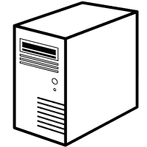
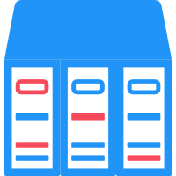
7.1 Overview of DDoS attacks
What is a DDoS attack?
A distributed denial-of-service (DDoS) attack sends malicious packets to the target through a large number of terminals distributed in various places at the same time in order to block the egress bandwidth of the target or exhaust its CPU resources and ultimately paralyze its service.
Botnet
Server
Launches DDoS attacks
Printer
Attacker
…
Application server
Other servers
Notes:
DDoS attacks occupy a large amount of network resources through a large number of legitimate requests to achieve the purpose of making services unavailable. It can be divided into:
Resource-consuming attacks: Through a large number of requests to consume normal bandwidth and protocol stack processing resources, the server can not work normally, and the network is overloaded to disrupt or even block normal network traffics, using, for example, Syn Flood, Ack Flood, UDP Flood;
Service exhaustion attacks: By submitting a large number of requests to the server, the memory or CPU of the server is exhausted, resulting in a method that cannot provide services, such as web CC attacks;

Slide 73
7.1 Overview of DDoS attacks (continued)
DDoS attack cause analysis:
Low Barrier: DDoS attack tools can be downloaded or purchased online;
Low Costs: 100 GB of attack traffic costs only a few hundred CNY;
Profits: an organized cybercrime chain with a clear division of labor has already been formed.
Identify explorable vulnerabilities
Bot grabber
Network attack software
Bot control terminal
Blackmail succeeded
End attacks after receipt of ransom
Rent servers
Identify targets
Launch attacks
Blackmail failed
Continue to attack
Notes:
After so many years of development, the DDoS industry chain has developed very mature, with clear division of labor and close cooperation between the groups, which has formed an orderly and continuously expanding underground market. And the benefit mode of each chain is also different。
Sell Attack Tools
Today, when DDoS is spreading across the board, many DDoS attack tools can be downloaded directly on the Internet for free. However, some software with better quality and special customized services still needs to be purchased from a professional production group. Software authors generally write customized software based on the needs of the attacking group and charge a fee. Generally ranging from a few hundred yuan to a thousand yuan。
Sell Attack Traffic
除了攻击工具，发起DDoS攻击还需要具备一定的流量。一般而言，通过抓“肉鸡”构建僵尸网络来获取流量耗时耗力，并且不够稳当。所以一些攻击者会选择向流量平台商租用流量。据安平情报团队调查，流量供应商会把所掌握的流量管理权限有偿提供给攻击者实施网络攻击，一般按时按量收费。
接单中介抽水
The high maturity of DDoS black production has also spawned an intermediary service in the industry chain: order intermediary. The most basic model is that the order-takers receive orders for "D orders", "C orders", and "sponsorship orders" based on different needs from customers, and then distribute the orders to attackers with corresponding attack resources and capabilities. According to the investigation of the current black market, the reward for completing a D order varies from 100 yuan to thousands of yuan based on the difficulty of the attack and the duration of the attack.。
攻击者攻击获利
在这个黑色产业中，DDoS攻击者不再是单纯发泄不满的年轻人，也不再是组织攻击的主角，他们更多是“客户”所雇佣的“打手”。通过接单中介或自己直接接活，黑产人员的月收入可达到数万元人民币。巨大的潜在利益驱使着攻击者们不断地铤而走险，也使得DDoS攻击成为互联网企业挥之不去的梦魇。

Slide 74
7.1 Overview of DDoS attacks (continued)
Trends in DDoS attacks:
“Fast Flooding” trend;
SYN flood is getting more powerful;
Pulsing attacks and attacks from multiple IPs have become a normal;
IoT terminals have become puppets of TCP session attacks and application layer attacks;
Personified attacks from real sources are emerging;
Attacks have been increasingly organized on platforms or even as a service.
Notes:
大流量攻击呈现”FastFlooding“ trend：
The peak attack traffic rises from 0 to tens of Gbps within a few seconds. "Fast Flooding" directly challenges the rapid response capability of the defense system。
Combined SYN Flood attack is powerful：
The SYN Flood traffic caused by malicious competition can be hundreds of Gbps, and the packet rate can reach hundreds of millions.。
Pulse attacks and multi-IP attacks become the norm：
Although the traffic of traditional DDoS attacks is large, they generally increase gradually, but the traffic of "pulse wave" DDoS attacks is not like this. Instead, all the attack traffic is concentrated and directly gives you a heavy blow. This type of new type The attack lasted more than an hour, or even several days, with a peak value of 350Gbps. Moreover, the pulse wave attack makes full use of the feature of the "equipment first" hybrid mitigation scheme to increase the attack intensity and expand the attack range. A new pulse wave attack starts from zero, reaches the maximum within a short time span, then returns to zero, and then returns to the maximum. The cycle repeats with a short interval of time.。
Multi-IP attacks, simultaneous pulse attacks on multiple IPs of the service；
IoT terminals become new puppets of TCP session exhaustion and application layer attacks：
The IoT network is developing rapidly, massive IoT terminals are turned into zombies, reflections are constantly being tapped, and the attack bandwidth is further increased。
真实源攻击拟人化：
Real-source attacks imitate normal user access behaviors, and the degree of personification is getting higher and higher, requiring more intelligent defense systems。
攻击日趋平台化和服务化：
攻击日趋平台化和服务化，促使其具备明显的“契约”交付精神，攻击越来越复杂，越来越持久。

Slide 75
7.2 Handling DDoS attacks
DDoS protection:
Resource isolation:
Cleanses and filters data sources through a set of strong DDoS protection systems and then sends normal traffic to servers;
Smart big data analysis:
As exceptional traffic data packets typically don't have the behaviors and characteristics of normal users, smart analysis systems can be introduced to analyze massive amounts of data and model valid users in order to accurately cleanse DDoS traffic.
Resource confrontation:
To put it simply, resource confrontation means using large-bandwidth resources and many servers to defend against DDoS traffic.

Slide 76
7.2 Handling DDoS attacks (continued)
Specific approaches to DDoS attack protection:
Hardware protection:
Add DDoS attack protection hardware at the bandwidth egress. However, this approach requires OPS from security professionals and lacks elasticity;
Reliance on ISPs:
Rely on ISPs to provide protection. However, this approach has single-line protection delay, narrow protection coverage, and poor service and technology reserves.
Complete cloud cleansing scheme:
Carry
Attack and business traffic
Cleanse
Business traffic
Sustain
Notes:
Complete cloud cleaning solution:
Acceptance: Relying on large bandwidth resources, the attack traffic and business traffic are inherited first to ensure the smoothness of the link;
Cleanse: With the help of excellent algorithms, the attack traffic is accurately identified and cleaned to ensure that the back-end business server only receives business traffic;
Capacity: With excellent service compatibility, it can accurately protect a variety of different types of services, and at the same time guarantee the service protection access experience;

Slide 77
7.3 DDoS protection scheme based on Anti-DDoS
Tencent Cloud DDoS protection (Anti-DDoS)
Tencent Cloud Anti-DDoS is an industry-leading DDoS protection service. It offers targeted protection solutions to help you resist DDoS attacks so as to guarantee business continuity and meet regulatory compliance requirements.
Anti-DDoS Basic
Anti-DDoS Pro
Anti-DDoS
Advanced
Chess Shield
Enabled by default and available free of charge
Protection against DDoS/CC attacks
Protection bandwidth of 2 Gbps
Self-Service change of bound IPs
Single-IP/Multi-IP instances
Protection bandwidth of 310 Gbps
Attack diversion to Anti-DDoS Advanced
Support for resources of Tencent Cloud and other clouds
Protection bandwidth of 400 Gbps
For the gaming industry
IP pool polling technology
User hiding and traffic scheduling
Notes:
DDoS基础防护：
DDoS 基础防护（Anti-DDoS Basic）是为腾讯云上用户免费提供的基础 DDoS 防护的服务。所有腾讯云主机都可免费享受 DDoS 基础防护，外网 IP 被攻击峰值超过 2Gbps 会执行 IP 封堵操作，封堵时长普通为 2 小时，大流量攻击封堵时长为 24-72 小时。
BGP高防包：
BGP 高防包是针对业务部署在腾讯云内的用户提升 DDoS 防护能力的付费产品。BGP 高防包直接对腾讯云上 IP 生效，无需更换 IP，购买后只需绑定需要防护的 IP 即可使用，具备接入便捷、零变更等特点。BGP 高防包支持单 IP 防护，同时提供多 IP 共享防护资源，满足多个 IP 地址都需要提升防护能力的需求。BGP 高防包只能绑定同一地域内的腾讯云设备，所购买的高防包需与源站所在地域一致。
腾讯云 BGP 高防包提供独享包与共享包两种类型的高防包，用户可根据需求自行选择：
独享包：提供一个 IP 独享防护能力。
共享包：提供多个 IP 共享防护能力。
BGP high-proof IP：
BGP 高防 IP（Anti-DDoS Advanced）It is a protection service that solves the DDoS attacks on users' businesses on Tencent Cloud. By configuring forwarding rules, users can direct attack traffic to Tencent's high-defense IP and clean them to ensure stable business availability. BGP high-defense IP can provide Tencent Cloud customers with ultra-large bandwidth DDoS and CC protection, up to 400Gbps protection. 30-line BGP line access eliminates cross-network delay and brings extremely fast and smooth access experience。
棋牌盾（Chess Shield）
Chess Shield is a targeted product for game industry users whose businesses are frequently subjected to DDoS attacks and CC attacks. Chess Shield uses the industry's unique IP polling technology to distribute business to a batch of Chess Shields IP, and is equipped with flexible user hiding and traffic scheduling strategies to resist large traffic attacks at low cost and ensure that core business is not affected.。

Slide 78
7.3 DDoS protection scheme based on Anti-DDoS (continued)
Anti-DDoS Advanced routes attack traffic to protect the backend business:
Configure Anti-DDoS Advanced as your external business IP to hide your real server IP.
Direct traffic to the Anti-DDoS data center, where it is cleansed before normal traffic is forwarded to your real server.
Attack traffic
Anti-DDoS Advanced
Real server
Traffic cleansing
Business traffic
Business traffic
Notes:
It is a protection service that solves the DDoS attacks on users' businesses on Tencent Cloud.
By configuring forwarding rules, users can direct attack traffic to Tencent's high-defense IP and clean them. BGP high-defense IP can provide Tencent Cloud customers with ultra-large bandwidth DDoS and CC protection, up to 400Gbps protection. 30-line BGP line access eliminates cross-network delay

Slide 79
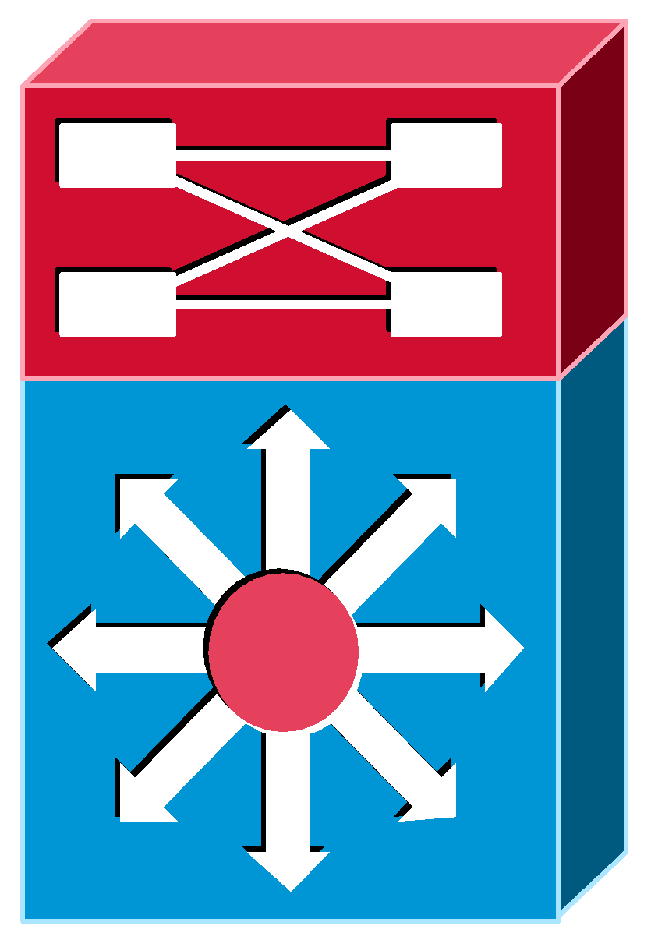
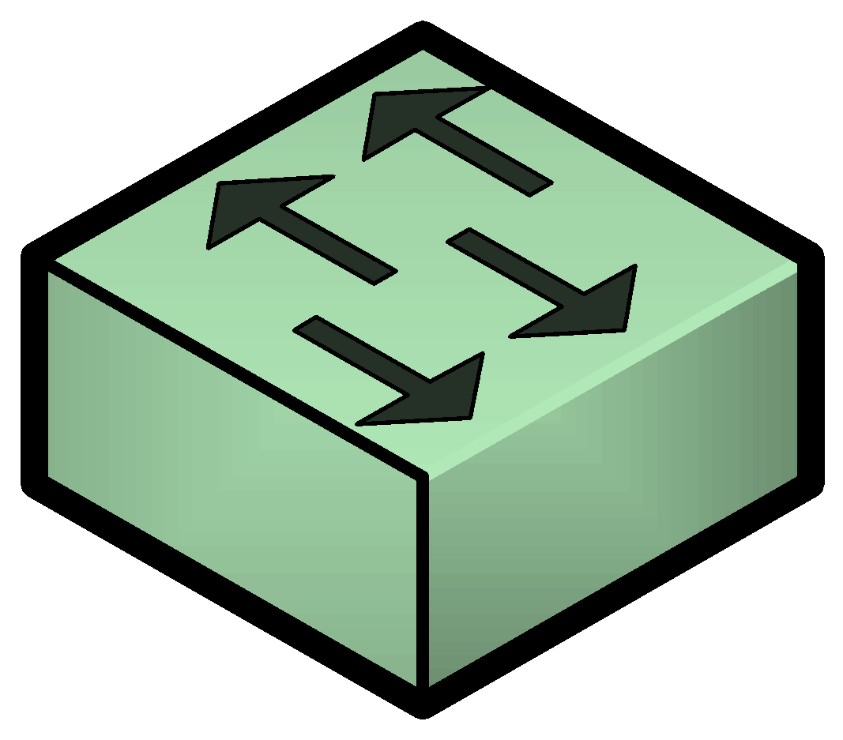
7.3 DDoS protection scheme based on Anti-DDoS (continued)
How Anti-DDoS works:
Double Cleansing:
It adopts a general policy to cleanse common attack traffic first;
Then, it adopts a custom policy to cleanse variant attacks.
One-to-Many support:
One Anti-DDoS Advanced instance supports 60 forwarding rules;
Each rule can be configured with 20 real server IPs.
Support for customers on and off the cloud:
A forwarding cluster can be built to forward traffic to internal or external
data centers after cleansing it.
ISP network
Traffic disposal after detection
Mirrored traffic
1:1 optical splitter
Attack detection cluster
BGP routing
External data center
Core router
Policy control cluster
Attack cleansing cluster
BGP reinjection
Anti-DDoS zone
Core gateway
CVM instances
(attacked)
CVM instances
(not attacked)
Anti-DDoS Advanced
forwarding cluster
Notes:
How to detect an attack：
Use splitting to do 1:1 traffic mirroring, bypass detection of mirrored traffic, without affecting customer services
The detection is based on traffic behavior modeling + AI intelligent engine to analyze whether there is an attack in the traffic。
How to clean the attack：
After detecting that a certain IP is attacked, it is led to the cleaning cluster protection through BGP routing. The clean traffic is injected back to the core routing, and finally flows to the customer's cloud server or through the forwarding cluster to the customer's IDC outside of Tencent Cloud.
The cleaning algorithm is mainly based on IP/TCP/UDP/HTTP(S) protocol specifications and human-machine identification to filter attack traffic. Does not involve or consult service load packets. The protection system is completely unaware of the customer's business data.

Slide 80
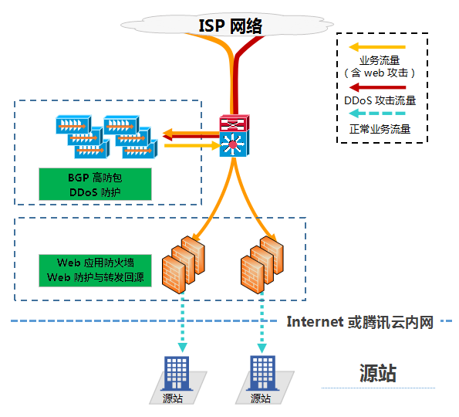
7.3 DDoS protection scheme based on Anti-DDoS (continued)
Anti-DDoS protection practices:
Use Anti-DDoS Pro together with WAF:
Providing DDoS protection capacity of hundreds of Gbps at one click, Anti-DDoS Pro can easily defend against DDoS attacks and ensure the smooth operation of your business;
WAF can block web attacks in real time to ensure the security of your business data and information.
Notes:
WAF：
Tencent Cloud Web Application Firewall (WAF) helps users in and out of the cloud to cope with Web attacks, intrusions, exploits, horse hacking, tampering, backdoors, crawlers, domain name hijacking and other website and Web business security protection issues.

Slide 81
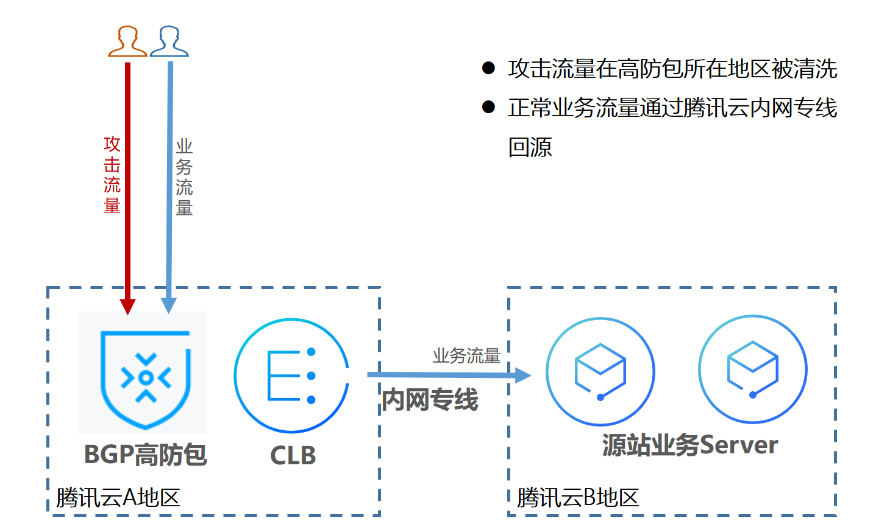
7.3 DDoS protection scheme based on Anti-DDoS (continued)
Anti-DDoS protection practices:
Remote protection with Anti-DDoS Pro:
The DDoS protection capability will no longer be limited by regions and can be as high as 300 Gbps.
The business traffic will be forwarded via private network Direct Connect with high reliability and a low latency.
You will enjoy all the advantages brought by Tencent Cloud BGP network. All your public IPs will be BGP IPs and the latency will be very low.
Notes:
方案背景：
受客观因素影响，BGP 高防包在北京、上海和广州可售卖的最大防护能力有所差异，上海可售卖的最大防护能力为300Gpbs，广州和北京两地可售卖防护能力均小于上海。除此之外，国内成都、重庆等区域尚未上线高防包产品。
如果用户业务源站部署在腾讯云，并且需要使用腾讯云非源站所在地区的 DDoS 防护能力时，可考虑本方案。
防护方案：
本方案主要由 BGP 高防包、CLB 负载均衡、源站业务 Server 组成。在具有 BGP 高防包资源的地区部署 CLB 负载均衡，并将其与 BGP 高防包进行绑定。配置 CLB 的内网回源规则，确保通过 CLB 的公网 IP 可以访问业务。
常态化情况下，业务可根据需要解析到源站业务的公网 IP（或直接解析到异地的 CLB 公网 IP），业务流量就近访问源站。
在发生攻击后，将业务解析到 CLB 的 IP，对 DDoS 攻击流量进行清洗，完成清洗后，由 CLB 通过内网专线将流量转发回到源站。
部署建议：
提前部署 BGP 高防包和 CLB 负载均衡。
建立业务可用性监测机制，在未部署自动切换机制的情况下，发现源站访问异常及时介入处理。
定期进行验证和演练，了解和熟悉方案细节，解决可能存在的问题。

Slide 82
7.3 DDoS protection scheme based on Anti-DDoS (continued)
Anti-DDoS protection practices:
Use Anti-DDoS Advanced with real servers:
Under normal circumstances, your business domain name is resolved to the outbound IP. Requests access the real server directly. DNS monitors watch over whether the applications are accessible on the real server in real time.
As soon as the DNS monitor detects that the outbound IP is not accessible, DNS will resolve the business domain name to the Anti-DDoS Advanced IP according to the preset switching rules. Anti-DDoS Advanced will cleanse and remove the attack traffic and forward clean traffic to the standby IP of the real server.
Notes:
方案背景：
部分用户业务对延时要求严格，或者受限于业务要求常态化情况下必须直接访问源站，此时可考虑结合源站的防护调度方案。
该方案可满足流量常态化情况下直接访问源站，但遭到攻击后可迅速具备防护能力的要求。
方案效果：
满足常态化情况下直接访问源站的需求。
适用于对延时要求非常严格的业务。
遭到攻击超出源站防护能力后，可自动切换到高防 IP 进行防护。
注意事项：
本方案依赖于 DNS 服务商，需要具备监控和智能切换功能。
为避免由于网络抖动等因素造成的误切换，确保监控效果，建议进行手动切换。
需提前完成源站备用 IP、高防 IP 转发规则等配置。
建议将源站备用 IP 与正常的业务 IP 分布在不同的物理线路，以获得更好的防护效果。
建议定期进行验证和演练，熟悉方案细节，解决可能存在的问题。

Slide 83
7.3 DDoS protection scheme based on Anti-DDoS (continued)
Anti-DDoS protection practices:
Switch online businesses to Anti-DDoS seamlessly:
For business applications:
Migrate standby and non-critical business applications first.
Migrate the applications during off-hours.
Solutions to exposed real server IP:
If attackers bypass Anti-DDoS Advanced and directly attack your real server, change the real server IP;
Before changing your real server IP, make sure that all factors that may expose it have been eliminated.
If you don't want to change it:
Do not use the same IP or an IP similar to the old IP in order to protect it from being scanned by attackers;
Prepare the standby linkage and IP in advance;
Set the scope of access sources to prevent malicious scanning.
Notes:
线上业务平滑迁移至大禹进行防护：
需求背景：
已上线的业务可能存在较多的特定设置和限制条件，且业务中断影响较大。因此，建议用户将已上线运行的业务切换到本产品之前，参考本节相关建议，采用合适的切换方式，规避可能存在的风险。
技术维度：
通过本地修改 hosts 文件来替代直接修改 DNS A 记录，由测试人员本地进行业务测试，验证可用性，测试延时等相关指标。
若已使用智能域名解析产品，可基于部分运营商或部分地域进行 DNS A 记录修改，先小范围将流量牵引到高防 IP 灰度上线再逐步完成全部业务切换。
减小 DNS 的 TTL，一旦出现问题可尽快切回。
提前准备回退方案，一旦出现问题可根据回退方案有序操作。
消除源站暴露因素的检查方法：
DNS 解析记录检查
检查该遭到攻击的旧源站 IP 上所有 DNS 解析记录，如子域名的解析记录、邮件服务器 MX（Mail Exchanger）记录以及 NS（Name Server）记录等，确保全部配置到高防 IP，避免部分解析记录直接解析成新更换的源站 IP。
信息泄露及命令执行类漏洞检查
检查网站或业务系统是否存在信息泄露的漏洞，如 phpinfo() 泄露、GitHub 信息泄露等。
检查网站或业务系统是否存在命令执行类漏洞。
木马、后门检查
检查源站服务器是否存在木马、后门等隐患。

Slide 84
7.3 DDoS protection scheme based on Anti-DDoS (continued)
Anti-DDoS protection practices:
Stress test for business systems:
Adjust protection policies:
Disable DDoS protection policies, or set the cleansing threshold for DDoS protection to a value higher than the maximum value of your stress test.
Limit the traffic and number of requests in the stress test:
The bandwidth of your stress test should be lower than 1 Gbps; otherwise, attack protection may be triggered.
The number of HTTP requests in your stress test should be no more than 20,000 requests per second (QPS); otherwise, attack protection may be triggered.
The number of new connections established per second, the maximum number of connections, and the number of inbound packets per second in your stress test should be less than 50,000, 2,000,000, and 200,000, respectively.
Evaluate the possible impact of the stress test in advance:
Conduct a stress test to thoroughly evaluate possible consequences and developing reasonable risk aversion measures.

Slide 85
7.3 DDoS protection scheme based on Anti-DDoS (continued)
Use cases of Anti-DDoS:
Attacks cause many users to be disconnected or result in slow access.
Attacks such as UDP packet attacks, ACK flood attacks, and game cheaters eventually lead to user loss.
Gaming
Anti-DDoS
Website
The leakage of the website server's real IP, traffic attacks, or application attacks can cause slow access to the website or even crash.
Finance
In banking, insurance, securities, and internet finance industries, DDoS attacks which make websites or applications inaccessible seriously undermine investor confidence.
Notes:
Game
The game industry is an industry with a high incidence of DDoS attacks. Malicious competitors can use CC attacks and other means to cause a large number of users to drop out of the game and slow access to the game, which will eventually lead to the loss of users.
After using Dayu BGP Anti-Defense, whether it is UDP packet attack, ACK Flood attack or game plug-in attack, it will be terminated in Dayu BGP Anti-Defense system, and the user's game will always be in a state of fast reachability.
Website
Website services are the hardest hit by DDoS attacks. Attackers can easily obtain the real IP of your website server through DNS resolution, and then launch a large-traffic attack or application-layer attack, resulting in slow website access or even directly paralyzed and inaccessible.
After using Dayu BGP Anti-Defense System, all attacks will be terminated in Dayu BGP Anti-Defense System with the large bandwidth and cleaning ability of Dayu BGP Anti-Defense System.
Finance
The vigorous development of Internet finance has also brought about fierce competition among industries, and malicious competitors often conduct DDoS attacks against other practitioners. If you suffer from a DDoS attack, it may cause your website to fail to open or APP to fail to log in, which will seriously affect investor confidence.
After using Dayu BGP Anti-Defense system, all attacks will be terminated in Dayu BGP Anti-Defense System with the ultra-large bandwidth and super cleaning ability of Dayu BGP Anti-Defense System, and your business will always be in a state of fast reachability.

Slide 86
Review Questions
Q1: What are the principles of handling peak business traffic?
Q2: How do we design User and Application Access Layer architecture for handling peak traffic?
Q3: How do we design a Web and Service Layer architecture for handling peak traffic?
Q4: How do we design a Cache Layer architecture for handling peak traffic?
Q5: How do we design an Async Message Queue architecture?
Q6: How do we design a Data Layer architecture for handling peak traffic?
Q7: How do we handle irregular traffic attacks?
Notes:
Think about the product points related to the question：
Question 1: User access layer-application access layer-web and service layer-cache layer-asynchronous processing layer-data layer
Question 2：
User access layer：CDN, DNS
Application access layer: CLB
Question 3: AS, business decoupling
4：Redis
5：CMQ, Ckafka
6：CDB, COS
7：Anti DDOS

Slide 87
Course Summary
This course covers:
Principles of architecture design for handling business traffic peak
How to design a user and application access layer architecture for handling peak traffic
How to design a web and service layer architecture for handling peak traffic
How to design a data cache architecture
How to design an async message queue architecture
How to design a data layer architecture for handling peak traffic

